Slide 1
CSCI S-96 Harvard Summer Session II
Data Mining for Business
Ted Kwartler
https://www.linkedin.com/in/edwardkwartler/
ehk116@gmail.com

Slide 2
Agenda
Start | End | Item
6:30 | 7:00 | Introductions
7:00 | 7:30 | Syllabus Review
7:30 | 7:45 | Community Learning Expectations
7:45 | 8:00 | Break
8:00 | 8:30 | Core Concepts in Data Mining
8:30 | 9:00 | Intro to R
9:00 | 9:30 | Q/A, Individualized help w/R environment Case Study Assignment

Slide 3
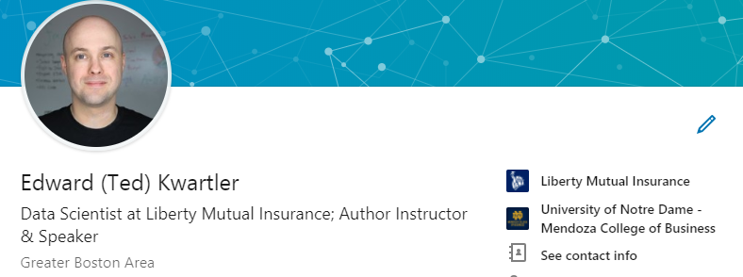
Introductions
Name
Where are you from?
Profession
Why did you take this course?
What do you hope to learn by the end of the course?
Tell us something interesting about yourself. Hobby? Family? Etc.
Notes:
DS is a community therefore invest in your cohort here, contribute to the open source ethos

Slide 4
Agenda
Start | End | Item
6:30 | 7:00 | Introductions
7:00 | 7:30 | Syllabus Review
7:30 | 7:45 | Community Learning Expectations
7:45 | 8:00 | Break
8:00 | 8:30 | Core Concepts in Data Mining
8:30 | 9:00 | Intro to R
9:00 | 9:30 | Q/A, Individualized help w/R environment Case Study Assignment

Slide 5
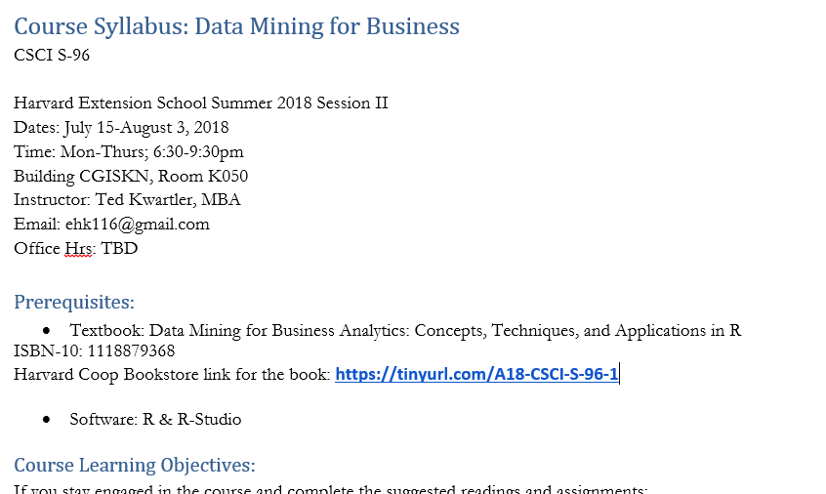
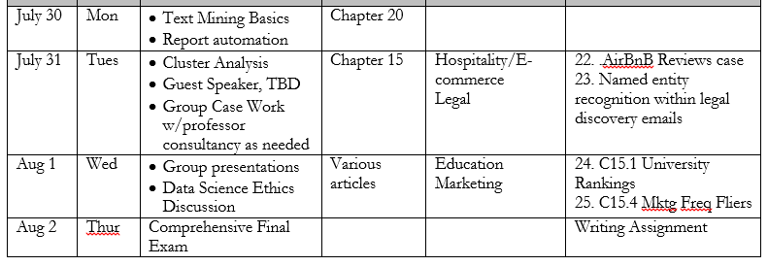
Syllabus Review

Slide 6
Agenda
Start | End | Item
6:30 | 7:00 | Introductions
7:00 | 7:30 | Syllabus Review
7:30 | 7:45 | Community Learning Expectations
7:45 | 8:00 | Break
8:00 | 8:30 | Core Concepts in Data Mining
8:30 | 9:00 | Intro to R
9:00 | 9:30 | Q/A, Individualized help w/R environment Case Study Assignment

Slide 7
Community Learning Expectations
I expect:
Kindness > Cleverness
Active learning & participation
To make adjustments along the way so learning will be engaging & fun
Academic rigor
I do not expect:
Expert programmers or production quality coding skills – not really a programming course
Significant math skills – not a heavy math course
My goal for your learning experience is that the topics are:
Interesting
Applicable as a professional or future business person
Perspective building as a consumer affected by these methods
Notes:
Always new approaches and applications for DS so adjustments and active learning is paramount

Slide 8
Community Learning Expectations
The class expects (of the instructor & cohort):
…
…
…
The class does not expect:
…
…
…
The class hopes learning this material will be:
…
…
…

Slide 9
Agenda
Start | End | Item
6:30 | 7:00 | Introductions
7:00 | 7:30 | Syllabus Review
7:30 | 7:45 | Community Learning Expectations
7:45 | 8:00 | Break
8:00 | 8:30 | Core Concepts in Data Mining
8:30 | 9:00 | Intro to R
9:00 | 9:30 | Q/A, Individualized help w/R environment Case Study Assignment

Slide 10
Data Mining in this course
Business Analytics – analyzing historical business data with basic math, SME rules, tallies, tables, summary statistics etc
Business Intelligence – what has happened or is happening that can help current business decisions, often done with visuals, powerpoint, dashboards i.e. tableau
Data Mining – includes machine learning (ML) & data science; applies more sophisticated methods to understand and predict business outcomes.
In this class we explore basic analytics, some business intelligence and ML methods in an effort to bring quantitative judgment to bear on business decisions.

Slide 11
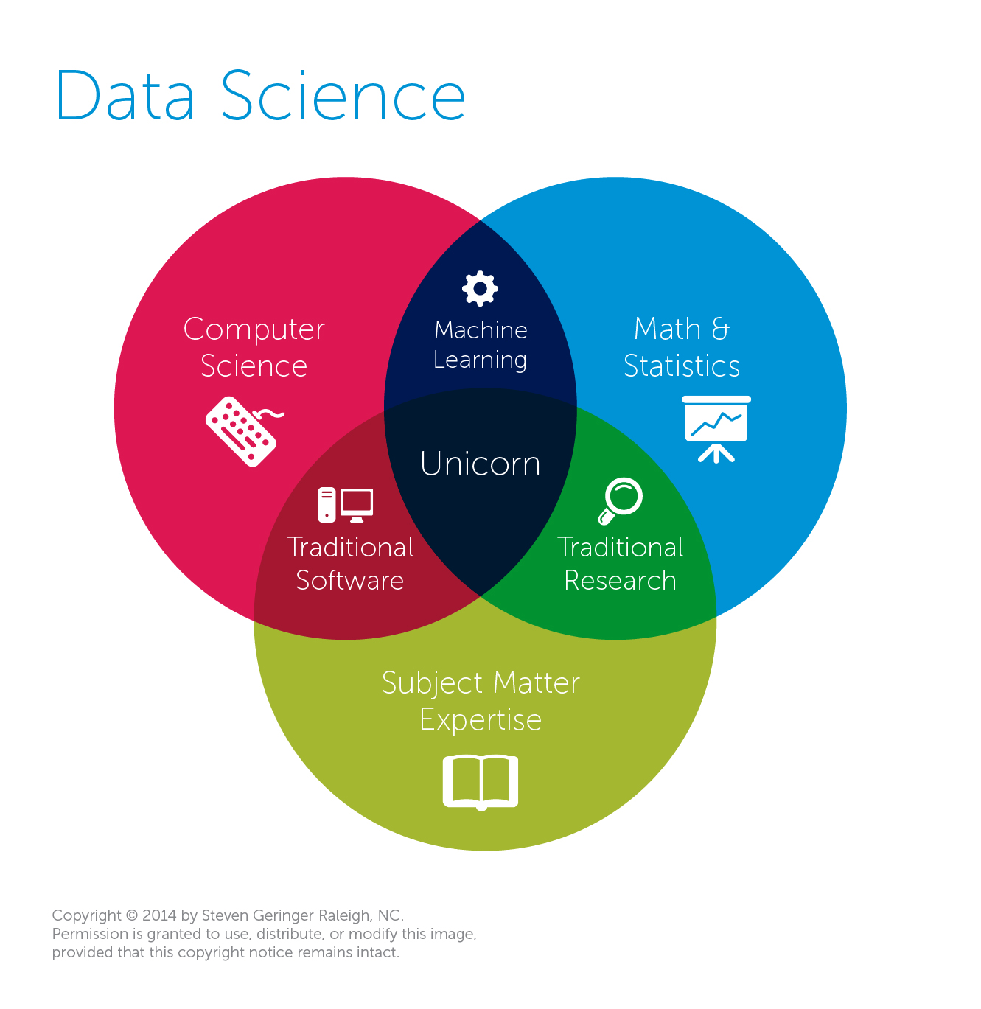
Data Mining & Science is almost always missing business acumen.
Traditional View
Data Science
The study of information with the goal of extracting meaningful insights and creating actionable recommendations.
*often does not require “big data” or extremely exotic approaches to have a business impact
Machine Learning
An outgrowth of artificial intelligence, machine learning is the set of tools, methodologies and techniques allowing a computer to “learn” about a specific situation.

Slide 12
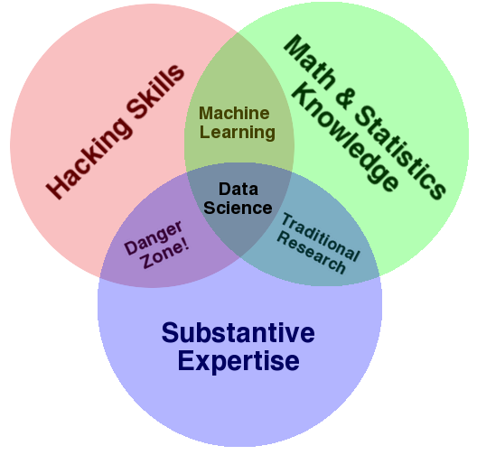
Make sure that Expertise include Business Implications
Another Popular View
Why hacking skills?
Data science takes creativity
Art & Science
A sprinkle of obsessive behavior to explain the data phenomenon
My $0.02
Both diagrams have expertise yet it is often overlooked. Many data scientists are technically sound but lack business acumen or substantive expertise.
© DataRobot, Inc. All rights reserved. - Confidential

Slide 13
Diagnosing & Defining a data mining project
Questions to Ask:
Is this a data mining problem? If so, what data would be helpful?
What is the current state?
What are the possible outcomes of the business scenario?
How will the outcome of the data mining project be used?
What is success for this project?

Slide 14

Pitfalls
Without asking these questions your efforts will:
Have scope-creep or never end!
Be difficult to define success
Be difficult to implement or have a limited impact

Slide 15

Let’s do this for real…
Meet Dale
Runs the analytics group at Busy-ness Corp a large conglomerate that makes, distributes and services corn dogs.
He looks miserable because senior leaders make his job harder than needed.
Let’s help Dale add some structure to his data mining projects.

Slide 16

Let’s do this for real
Hey Dale, its me…the boss.
I read in the WSJ that everyone should be using blockchain. Should we?
Is this a data mining problem?
What is the current state?
What are the possible outcomes of the business scenario?
How will the outcome of the data mining project be used?

Slide 17

Let’s do this for real
Your Daleness, I work in marketing and want to look intelligent (hence the glasses). I want to do a mailing to prospective corndog eaters. Can you identify how many postcards we should send & ROI?
Is this a data mining problem?
What is the current state?
What are the possible outcomes of the business scenario?
How will the outcome of the data mining project be used?

Slide 18

Let’s do this for real
Dale-areno! I think we are getting a lot more calls than usual about defective corn dogs. Can you look into whether or not that’s true?
Is this a data mining problem?
What is the current state?
What are the possible outcomes of the business scenario?
How will the outcome of the data mining project be used?

Slide 19

Let’s do this for real
The Notorious DALE, let’s forecast how many of our current corn dog debtors will be delinquent. Is that getting better or worse over time?
Is this a data mining problem?
What is the current state?
What are the possible outcomes of the business scenario?
How will the outcome of the data mining project be used?

Slide 20

Let’s do this for real
The East coast regional corn dog sales are up! I wonder if my region is worse than the West coast region.
Is this a data mining problem?
What is the current state?
What are the possible outcomes of the business scenario?
How will the outcome of the data mining project be used?

Slide 21

Let’s do this for real
Despite that idiot in marketing selling defective dogs, we need a new warehouse in the East region. Which zip code should we build it in to support a strong workforce?
Is this a data mining problem?
What is the current state?
What are the possible outcomes of the business scenario?
How will the outcome of the data mining project be used?

Slide 22


Let’s call Dale to tell him what we learned.
https://www.motionelements.com/stock-video-3902092-successful-black-businessman

Slide 23
Types of Problems
Retrospective
Descriptive
Data Science
Predictive
Supervised Learning
Classification
Binary
Multi-Class
Continuous
Forecasting
Unsupervised Learning
Associative System

Slide 24
Types of Problems
Retrospective
Descriptive
Data Science
Predictive
Supervised Learning
Classification
Binary
Multi-Class
Continuous
Forecasting
Unsupervised Learning
Associative System
How did we do last quarter?
Usually point in time and standalone information not summary.

Slide 25
Types of Problems
Retrospective
Descriptive
Data Science
Predictive
Supervised Learning
Classification
Binary
Multi-Class
Continuous
Forecasting
Unsupervised Learning
Associative System
What is the average number of donuts served each morning?
Retrospective but can be summary and/or in comparison to other data.

Slide 26
Types of Problems
Retrospective
Descriptive
Data Science
Predictive
Supervised Learning
Classification
Binary
Multi-Class
Continuous
Forecasting
Unsupervised Learning
Associative System
Ask yourself is there an outcome variable that we want to predict.
Will the next person that calls accept the credit card offer?
The outcome is 1 = yes, 0=no, they will accept.

Slide 27
Supervised Learning
Goal: Predict a single “target” or “outcome” variable
Training data, where target value is known
Score to data where value is not known
Methods: Classification and Prediction

Slide 28


Supervised Learning
Inferring a function from labeled data.
“Learn from telling”, “Look at my data and I will tell you what to predict”
Data Setup
Method
Business Examples
Application
Marketing-Will a customer buy yes or no? How much will a customer spend?
Operations- Will an applicant default? When will a machine break?
Sports Analytics- How many points will the Bears’ QB score? What is the Bears’ probability of winning?
Flat “Excel” file. Each row is a record or observation. Each column is an attribute of the record.
One column is the outcome, y or target attribute.
Modeling e.g. K-NN, linear regression, decision tree, random forest etc.
Use the model to make predictions for the target label on the new data.

Slide 29
Types of Problems
Retrospective
Descriptive
Data Science
Predictive
Supervised Learning
Classification
Binary
Multi-Class
Continuous
Forecasting
Unsupervised Learning
Associative System
Ask yourself is there an outcome variable that we want to predict.
Will the next person that calls accept the credit card offer?
The outcome is 1 = yes, 0=no, they will accept.

Slide 30
Supervised: Classification
Goal: Predict categorical target (outcome) variable
Examples: Purchase/no purchase, fraud/no fraud, creditworthy/not creditworthy…
Each row is a case (customer, tax return, applicant)
Each column is a variable
Target variable is often binary (yes/no)

Slide 31
Types of Problems
Retrospective
Descriptive
Data Science
Predictive
Supervised Learning
Classification
Binary
Multi-Class
Continuous
Forecasting
Unsupervised Learning
Associative System
Ask yourself is there an outcome variable that we want to predict.
Will the next patron order a wine, beer, or cocktail?
The outcome is one of three classes, wine, beer, or cocktail.

Slide 32
Types of Problems
Retrospective
Descriptive
Data Science
Predictive
Supervised Learning
Classification
Binary
Multi-Class
Continuous
Forecasting
Unsupervised Learning
Associative System
Ask yourself is there an outcome variable that we want to predict.
How many ice cream cones will we sell on an 85 degree, Saturday?
(the outcome is a continuous 0 to some number of cones)

Slide 33
Supervised: Prediction
Goal: Predict numerical target (outcome) variable
Examples: sales, revenue, performance
As in classification:
Each row is a case (customer, tax return, applicant)
Each column is a variable
Taken together, classification and prediction constitute “predictive analytics”

Slide 34
Types of Problems
Retrospective
Descriptive
Data Science
Predictive
Supervised Learning
Classification
Binary
Multi-Class
Continuous
Forecasting
Unsupervised Learning
Associative System
Ask yourself is there an outcome variable that we want to predict.
How much corn meal will we need for our corn dogs this month?
(there is an outcome, and the data is time related)

Slide 35
Types of Problems
Retrospective
Descriptive
Data Science
Predictive
Supervised Learning
Classification
Binary
Multi-Class
Continuous
Forecasting
Unsupervised Learning
Associative System
Ask yourself is there an outcome variable that we want to predict.
Can our customer data base be grouped in some meaningful way?
(there is no clear outcome to predict, we can observe and explore the clusters within the customer db)

Slide 36
Unsupervised Learning
Goal: Segment data into meaningful segments; detect patterns
There is no target (outcome) variable to predict or classify
Methods: Association rules, data reduction & exploration, visualization

Slide 37
Unsupervised Learning
Trying to find hidden structure in unlabelled data.
“Learn from observing”, “Look at my data and tell me about it”
Data Setup
Method
Business Examples
Application
Marketing-Find customer segments for specific marketing campaigns.
Operations-Identify locations for cell towers based on population density and area characteristics.
Text Analysis- Topic modeling of articles
Flat “Excel” file. Each row is a record or observation. Each column is an attribute of the record.
Clustering e.g. K-Means, Hierarchical Clustering etc
In new data find the customers/observations that most likely are part of a particular cluster.

Slide 38
Types of Problems
Retrospective
Descriptive
Data Science
Predictive
Supervised Learning
Classification
Binary
Multi-Class
Continuous
Forecasting
Unsupervised Learning
Associative System
Ask yourself is there an outcome variable that we want to predict.
What should we offer customers that bought the corn dog?
(There is not really a distinct outcome, only observed data similar to the unsupervised example. Should we offer additional dogs, condiments, orange soda, red wine, steak etc. Among all choices, how are items associated based on purchase history?)

Slide 39
Unsupervised: Association Rules
Goal: Produce rules that define “what goes with what”
Example: “If X was purchased, Y was also purchased”
Rows are transactions
Used in recommender systems – “Our records show you bought X, you may also like Y”
Also called “affinity analysis”

Slide 40
Your turn…
Methods
Scenarios
Retrospective
Descriptive
Data Science
Predictive
Supervised Learning
Classification
Binary
Multi-Class
Continuous
Forecasting
Unsupervised Learning
Associative System
Will the Celtics win the game?

Slide 41
Your turn…
Methods
Scenarios
Retrospective
Descriptive
Data Science
Predictive
Supervised Learning
Classification
Binary
Multi-Class
Continuous
Forecasting
Unsupervised Learning
Associative System
How did same stores sales change year over year?

Slide 42
Your turn…
Methods
Scenarios
Retrospective
Descriptive
Data Science
Predictive
Supervised Learning
Classification
Binary
Multi-Class
Continuous
Forecasting
Unsupervised Learning
Associative System
What should we place next to the cheese in the grocery cooler?

Slide 43
Your turn…
Methods
Scenarios
Retrospective
Descriptive
Data Science
Predictive
Supervised Learning
Classification
Binary
Multi-Class
Continuous
Forecasting
Unsupervised Learning
Associative System
How many patients should we expect in the urgent care tomorrow?

Slide 44
Your turn…
Methods
Scenarios
Retrospective
Descriptive
Data Science
Predictive
Supervised Learning
Classification
Binary
Multi-Class
Continuous
Forecasting
Unsupervised Learning
Associative System
How many wickets will the Chennai SuperKings make?

Slide 45
Your turn…
Methods
Scenarios
Retrospective
Descriptive
Data Science
Predictive
Supervised Learning
Classification
Binary
Multi-Class
Continuous
Forecasting
Unsupervised Learning
Associative System
What are our customer personas and how are they similar by account attribute?

Slide 46
Your turn…
Methods
Scenarios
Retrospective
Descriptive
Data Science
Predictive
Supervised Learning
Classification
Binary
Multi-Class
Continuous
Forecasting
Unsupervised Learning
Associative System
How many fish did each vessel catch yesterday?

Slide 47
Your turn…
Methods
Scenarios
Retrospective
Descriptive
Data Science
Predictive
Supervised Learning
Classification
Binary
Multi-Class
Continuous
Forecasting
Unsupervised Learning
Associative System
How many fish did each vessel catch yesterday?

Slide 48
Your turn…
Methods
Scenarios
Retrospective
Descriptive
Data Science
Predictive
Supervised Learning
Classification
Binary
Multi-Class
Continuous
Forecasting
Unsupervised Learning
Associative System
Will the Celtics win the game?
How many wickets will the Chennai SuperKings make?
What should we place next to the cheese in the grocery cooler?
How did same stores sales change year over year?
How many patients should we expect in the urgent care tomorrow?
What are our customer personas and how are they similar by account attribute?
How many fish did each vessel catch yesterday?

Slide 49
Quiz!
Is there a target variable in unsupervised learning?
True or False? Data Science is defined as the study of information with the goal of extracting meaningful insights and creating actionable recommendations.
Data scientists need what type of skills?
What is an example of a supervised learning business question?
Name three attributes would you need for that example.

Slide 50
Agenda
Start | End | Item
6:30 | 7:00 | Introductions
7:00 | 7:30 | Syllabus Review
7:30 | 7:45 | Community Learning Expectations
7:45 | 8:00 | Break
8:00 | 8:30 | Core Concepts in Data Mining
8:30 | 9:00 | Intro to R
9:00 | 9:30 | Q/A, Individualized help w/R environment Case Study Assignment

Slide 51
Intro to R
Learning Objectives
What is R?
What is R Studio?
Why learn R?
Scripting Structure

Slide 52

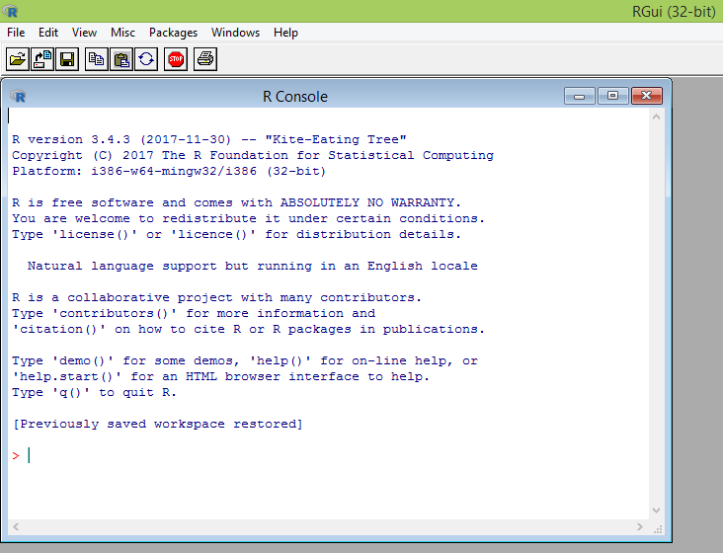
What is R?
Flexible
Open source
Academic but growing in industry
Language agnostic, SQL, Weka, C, Fortran, Java etc
R is a language and environment for statistical computing and graphics. It is the most popular statistical software in circulation today, and is used by more than 2 million data scientists and statisticians worldwide.
How Companies Use R to Compete in a Data-Driven World, Data-informed.com

Slide 53

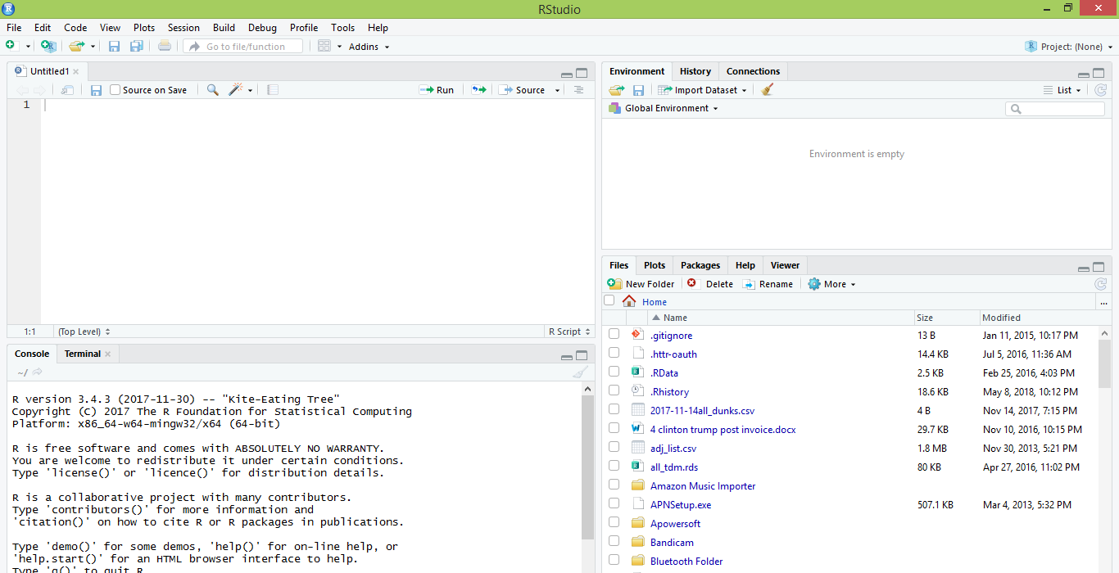
What is R Studio?
IDE – Integrated Development Environment
Adds additional functionality e.g. git, shiny projects, markdown templates
R studio is the most popular IDE for R although there are others & you don’t actually need it to perform R tasks.

Slide 54
What is the relationship between R & R studio?
Nice interface & additional functionality for faster programming, analysis & production.
Statistical & graphing software
R Studio sits atop of the installed R version. Without base R, R studio cannot function. By programmatically accessing base R, R Studio improves the interface and functionality.

Slide 55
R Studio has four main panes
Scripting
Environment
Commands are written & adjusted here then executed in the console. Then saved for future quick execution.
List of objects & values
e.g. loaded “excel” files
Files, Plots, Packages, Help
Console
Find files, load packages, see visualizations and quickly find help
Execution of scripts and commands, data exploration and code results
This class will use R-Studio in a hosted Linux server but R can be locally installed on both Apple and Windows machines too.

Slide 56
R: Where is it being used?
Media
Google
Facebook
Twitter
Foursquare
Kickstarter
New York Times
Economist
Services
Zillow
Trulia
eHarmony
DataSong
PredictWise
Nationwide
Finance
Lloyd’s Bank
Credit Suisse
American Century
Australia and New Zealand Banking Group
Technology
SAS
Oracle
IBM
Teradata
Coursera
SAP
DataCamp
Alteryx
TIBCO
OneTick
Amazon
Google
Microsoft
U.S Government
Food & Drug
Administration
National Weather
Service
National Institute
of Standards
in Technology
R is ubiquitous in various industries used for analysis, prototyping and visualization. However, more often python is used in production environments.

Slide 57
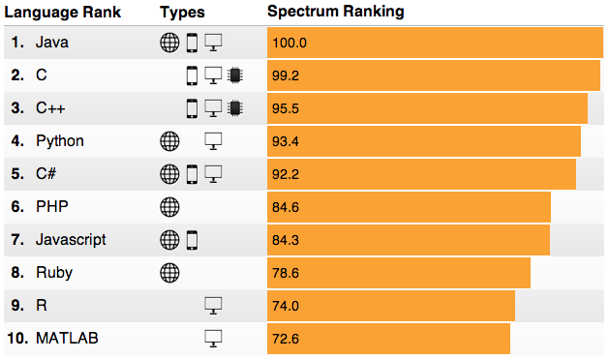
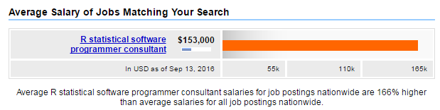
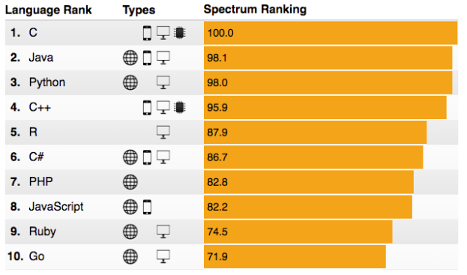
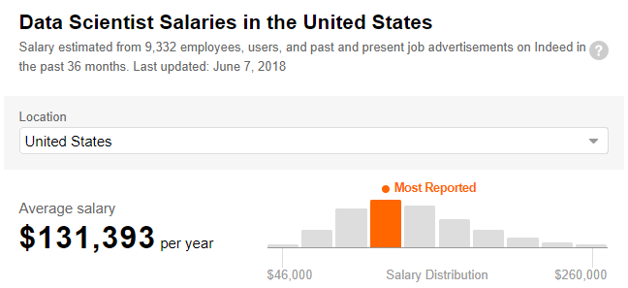
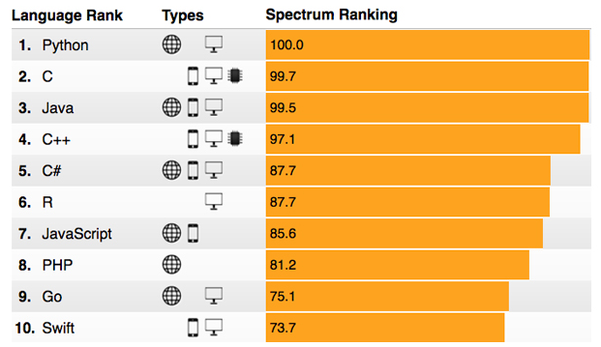
R: Do you get rewarded for knowing it?
Top 10 Languages ieee.org
Example Salaries
2015
2016
2017
R salaries are very strong and given the language’s popularity, the need for more R fluent business leaders and programmers is likely to remain for some time.

Slide 58
Ok, it’s awesome but…
Pros
Cons
VERY extensible
10K+ packages
Built by stats, made for stats
Free, open source
Cutting edge
Diverse applications
Outstanding graphical capabilities
Large community based help
Tough to do “big data”
In memory data constraints w/o extra effort
Official documentation is terse
Not as polished as a commercial application
Slow compared to lower level languages
Production worthy apps can be difficult to create
Large community based help

Slide 59
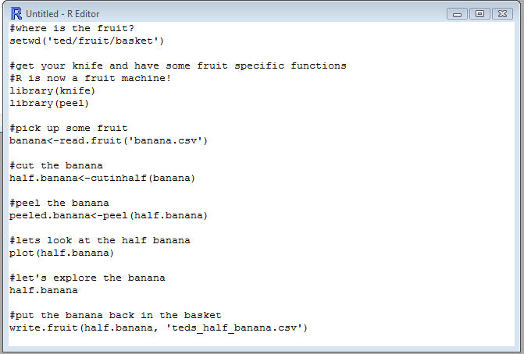
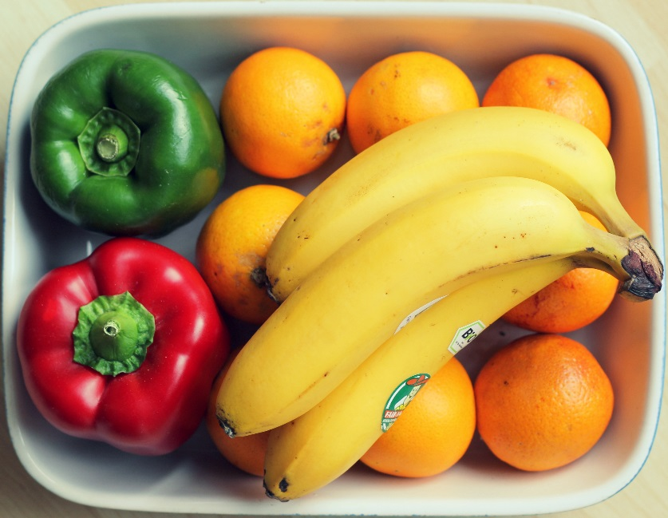
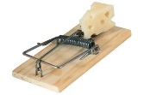
R Uses Functions, Libraries & Objects
Let’s eat a banana for breakfast. Where is the fruit?
Use the function setwd (set working directory) to declare the folder where your data files are within quotes…the fruit basket containing the stuff you want. Ever wonder what the current working directory is? Use getwd() with empty parentheses!
The folder path needs to be in quotes and slashes are reversed in Windows not on Apple or Linux.

Slide 60


R Uses Functions, Libraries & Objects
Found the fruit! What tools do I need?
Use library() with the name of a specialized package, without quotes, to change R to a specialized piece of software.
Before loading a library use install.packages(“name of package”). You only need to do this once.

Slide 61

R Uses Functions, Libraries & Objects
Now R is a fruit cutting machine. Let’s pick our fruit.
Use a read.csv() or similar function to get the object from the working directory. There are multiple read-like functions to get SQL connections, APIs, Excel, and other file types.
The object name must be in quotes and actually be in the directory…watch spelling and capitalization!.

Slide 62
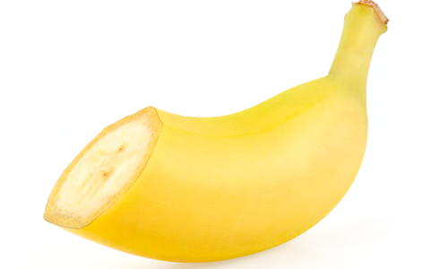
R Uses Functions, Libraries & Objects
Use a function from the knife library to create a new object.
Functions are applied to an object to change it in some way or create a new object. Here the R instance has two objects, banana & half.banana
Be careful, you can overwrite an object pretty easily!

Slide 63


R Uses Functions, Libraries & Objects
Use a function from the hand library to create another new object.
Functions are applied to an object to change it in some way or create a new object. Here the R instance has three objects, banana, half.banana & peeled.banana
Be careful, you can overwrite an object pretty easily!

Slide 64
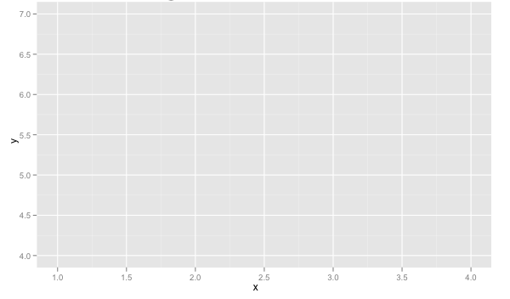
R Uses Functions, Libraries & Objects
Now it’s time to consume the outcome.
Here we call plot on the object to consume it after our adjustments.
You can save files, view graphs, adjust databases, send emails, make reports, update values and more as the result of an R script.
Be careful, you can overwrite objects when SAVING too!

Slide 65







Let’s Review.
1
Use setwd() to point to your files.
Load some customized libraries with library() for your specific analysis and methodology.
2
Read in the file so the object is “in-memory” with read.csv() or similar.
3
Apply a function from a library to adjust or create new objects in memory. The pseudo code for this is:
4
5
object<-function(applied to object)
6
Consume the results by saving, plotting etc.

Slide 66
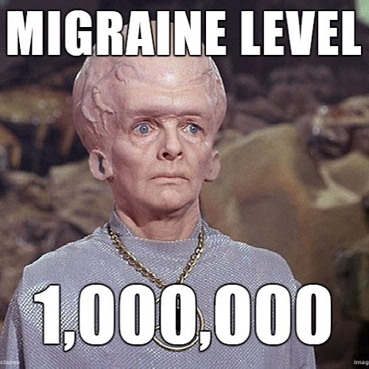
You should have each received a URL address.
This is your personal server for the course. At that URL you will have a new R Studio install.
This is done to avoid local differences among our computers although you can install R on your laptop.
Please sign up at github.com so we can push code and lessons to your server.

Slide 67
Let’s Practice!
Open:
A_Basic_Test_Drive.R
Simple Operators ie “+”
Define Variables using “<-”
Review objects and types
Use paste()
Find help with “?”
Create a data.frame()
Add a column
Navigate the DF
write.csv()
read.csv()
scatterplot()
tables()
barplot()
Saving a visual as a .jpeg
“IF” Conditional loops
“FOR” loops
Open the first script, get familiar with the basic R operations by execution.

Slide 68
Visuals in Base R - Distribution Plots
Display “how many” of each value occur in a data set
Or, for continuous data or data with many possible values, “how many” values are grouped into “bins”

Slide 69
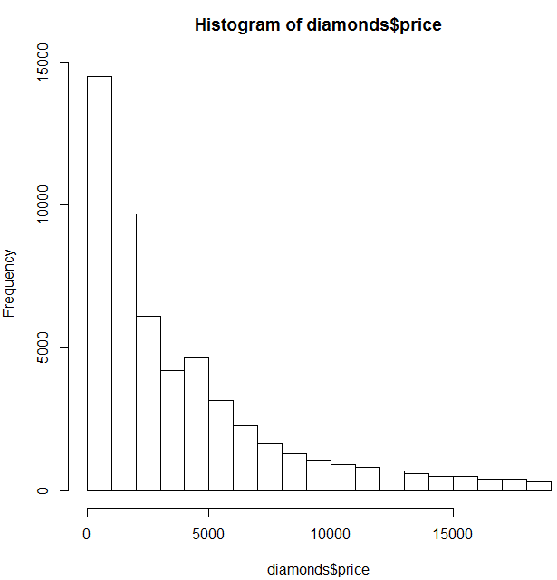
Visuals in Base R - Histogram
hist(diamonds$price)
Programmatically
Histogram shows the distribution of a variable
Be aware “breaks” (# of bins) will affect the visual
About 4800 of the diamonds are prices between $4 & $5k
I want to examine the distribution of a continuous variable.
Data Scientist
Often a business person will look for non-normal, or unexpected distributions. They will be attracted to items not reinforcing their bias.
Business Person

Slide 70
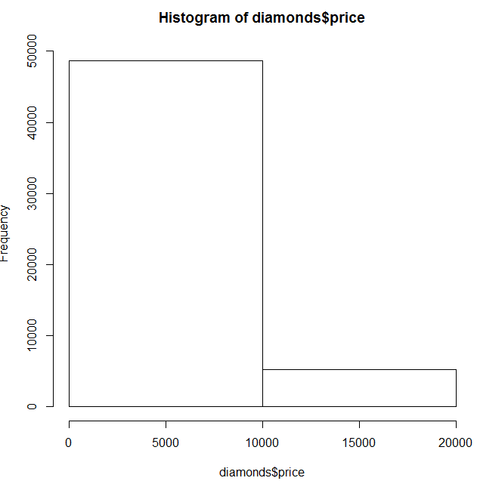
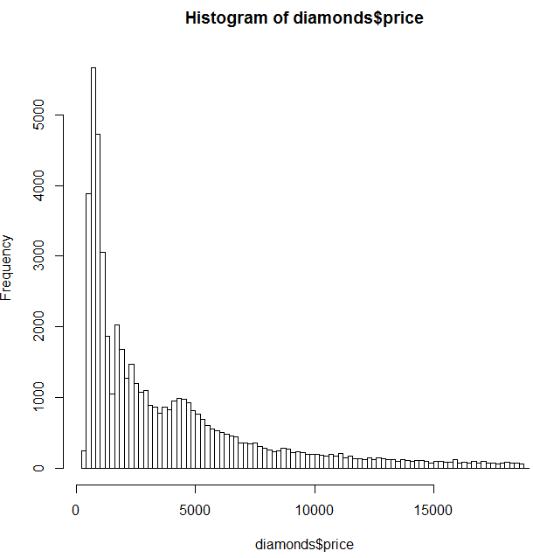
Visuals in Base R - Histogram
To Few Breaks
To Many Breaks
hist(diamonds$price, breaks =2)
hist(diamonds$price, breaks =100)
Audiences could draw the wrong conclusions, “most diamonds are around $10K” or “most diamonds are $200”

Slide 71
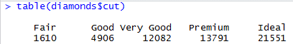
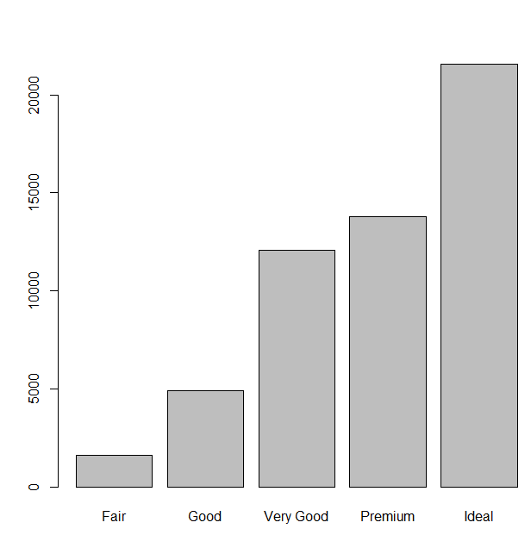
Visuals in Base R – Bar Chart
table(diamonds$cut)
barplot(table$diamonds$cut)
Programmatically
I want to examine the distribution of a factor variable.
Data Scientist
Besides reviewing for prior biases, could be overwhelmed with too many factor levels, similar to getting breaks right, so grouping may be needed.
Business Person
Use a bar chart to visualize the tally of categorical variables and understand their distribution.

Slide 72
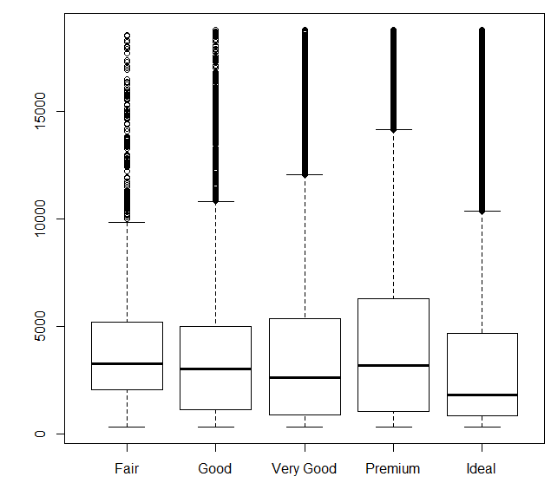
Visuals in Base R - Boxplots
boxplot(diamonds$price~ diamonds$cut)
Show multiple distributions side by side in a compact manner.
Here you are examining the distribution of price by the cut (a factor with distinct levels)

Slide 73
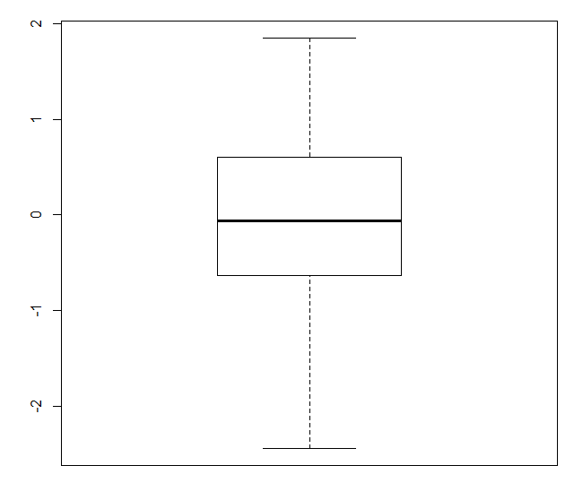
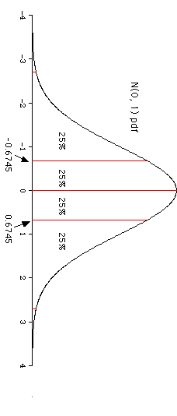
Understanding a boxplot
Boxplot of Normal Distribution
A box plot is a rotated distribution corresponding to specific values.

Slide 74
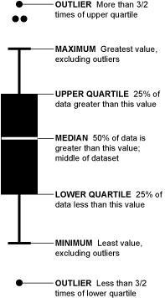
Understanding a boxplot

Slide 75
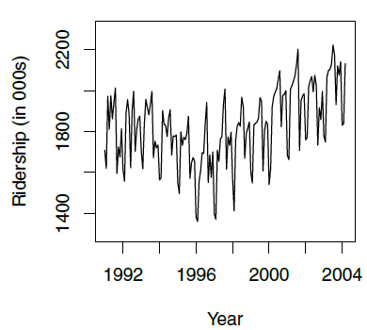
Visuals in Base R – Line Charts
Amtrak Rider Data
Often used with time series data
Sometimes, if data points are linked in a different fashion other than time, a line chart is helpful.
Beware of “spaghetti” charts that are not informative.
ridership.ts <- ts(Amtrak.df$Ridership, start = c(1991, 1), end = c(2004, 3), freq = 12)
plot(ridership.ts, xlab = "Year", ylab = "Ridership (in 000s)", ylim = c(1300, 2300))

Slide 76
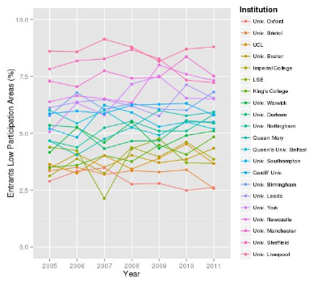
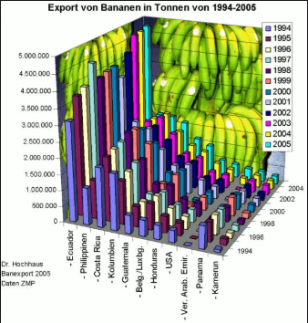
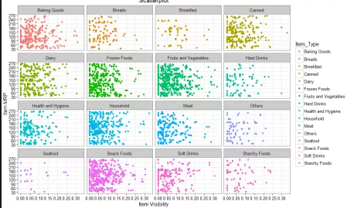
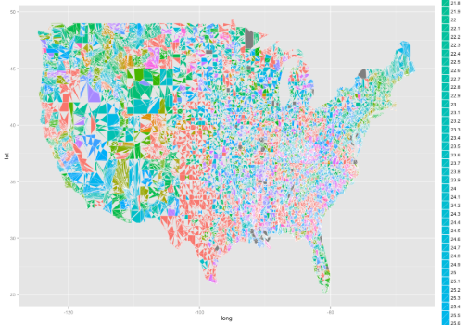
Spaghetti Charts
Aesthetics should be minimized, and always think about adding a second graph instead of another data series.

Slide 77
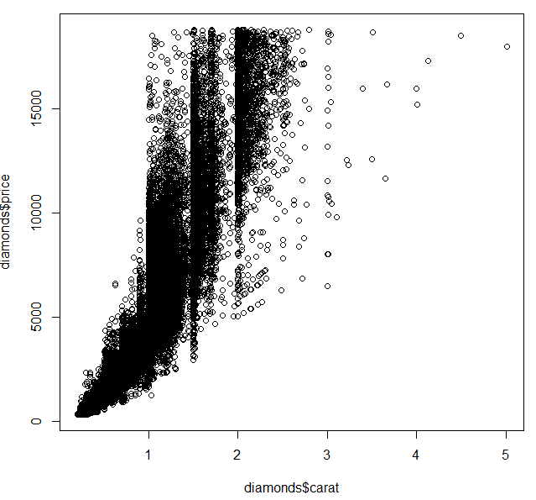
Visuals in Base R - Scatterplot
To understand the relationship between two variables, use a scatter plot.
plot(diamonds$carat,
diamonds$price)
Programmatically
What’s the relationship between two variables. Do I see a pattern?
Data Scientist
“I see a pattern, but this is ugly, what do the straight vertical patterns tell me?
Business Person

Slide 78
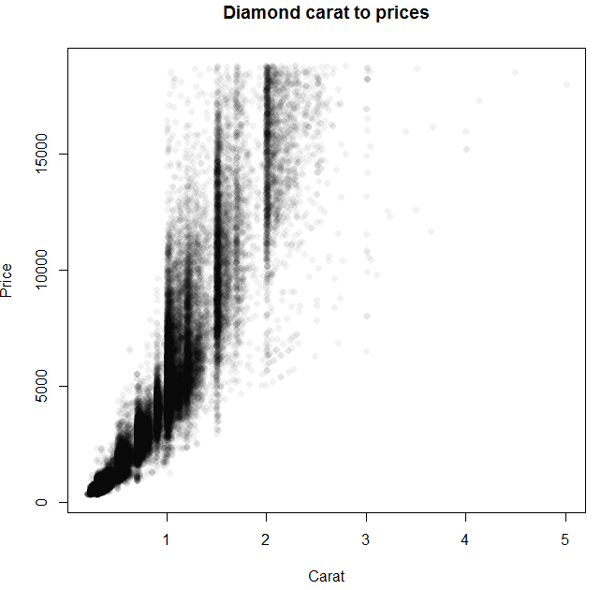
Scatterplot – with Transparency
Here we apply the scales function “alpha” to adjust the transparency and help deal with over plotting.
library(scales)
plot(diamonds$carat, diamonds$price, main= "Diamond carat to prices",
ylab = "Price", xlab = "Carat", col = alpha('black', 0.05), pch=16)
Programmatically
What’s the relationship between two variables. Do I see a pattern?
Data Scientist
Now a business person can more easily observe the data clusters at ¼ increments for carat and a positive trend for carat to price.
Business Person

Slide 79
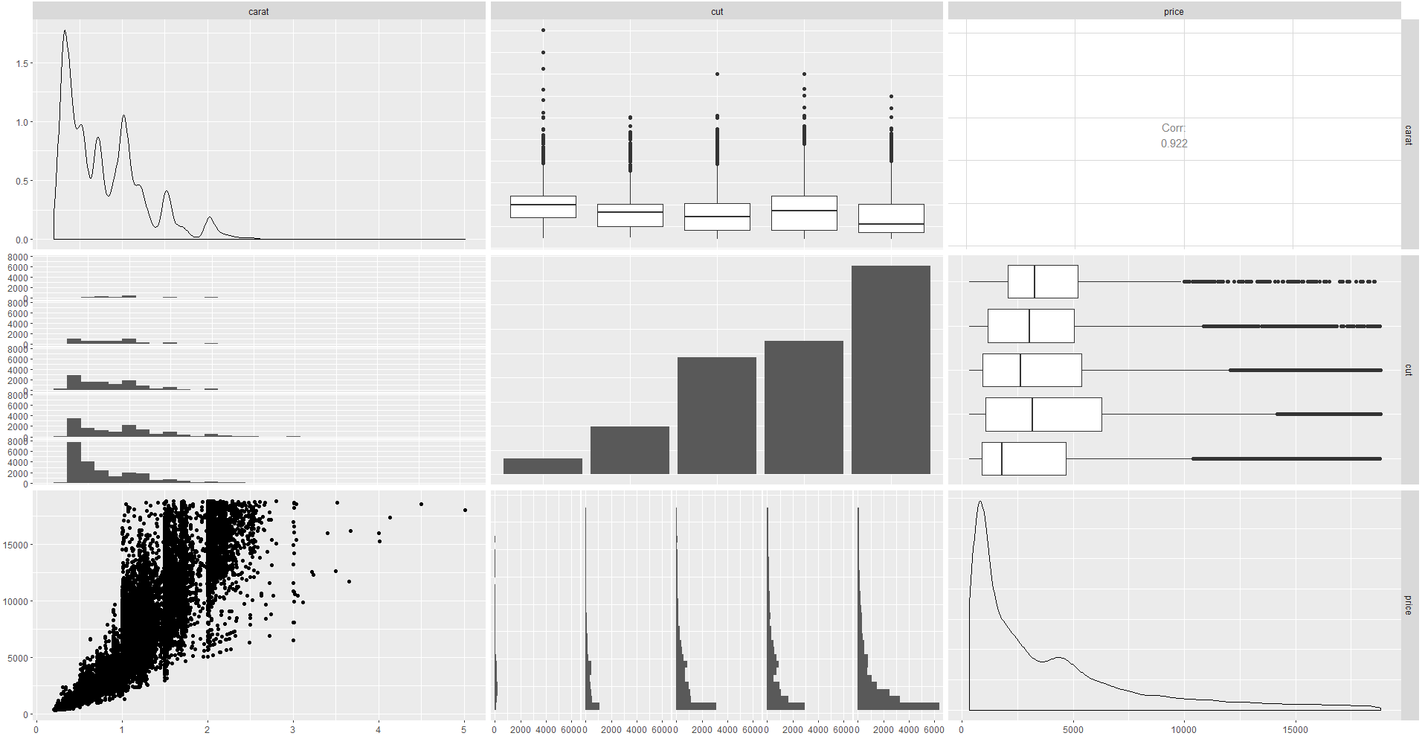
Multidimensional Plots
library(GGally)
ggpairs(diamonds[, c(1, 2, 7)])
These can easily be to much information for the audience to comprehend at once so be cautious.

Slide 80
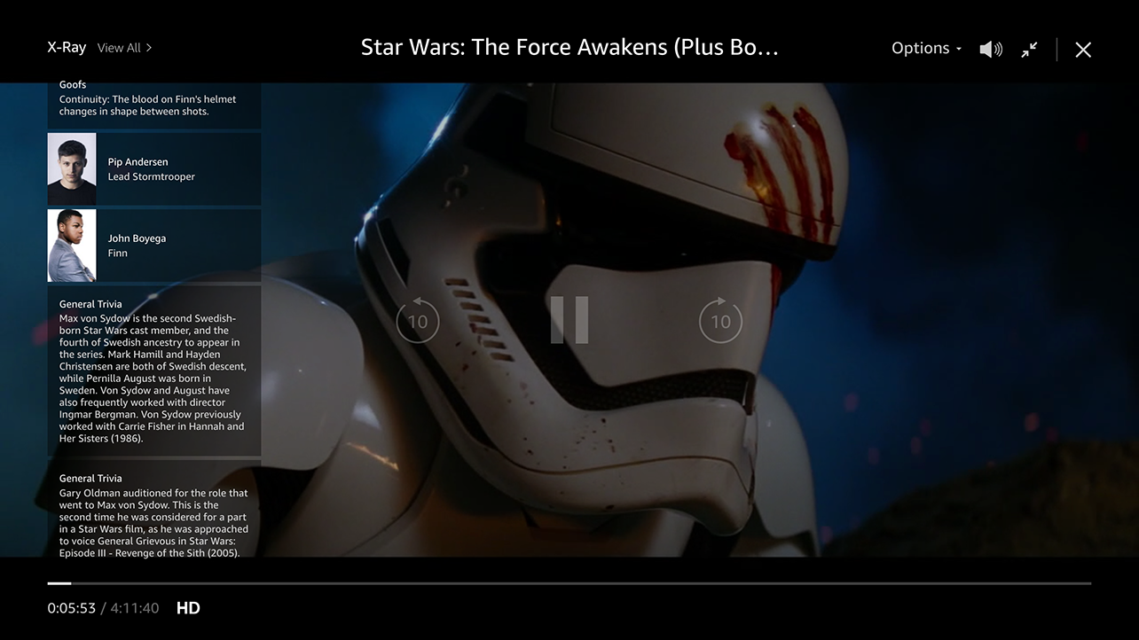
Do or Do Not There is No Try…

Slide 81
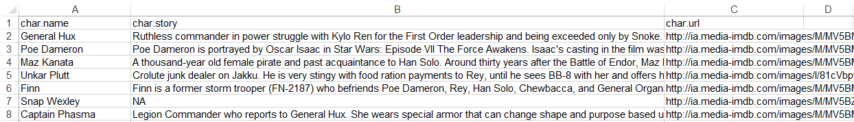
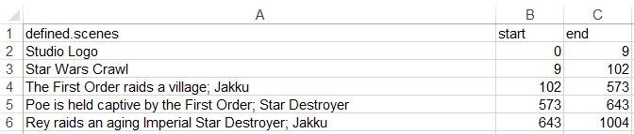
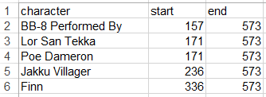
Amazon’s X-Ray has a lot of Information
Character Background
Official Scenes
Character Appearances

Slide 82
Let’s Practice!
Open:
B_Functions_EDA_Viz.R
read.csv
dim()
table()
indexing
subset()
sample()
as.matrix()
barplot()
ggplot()
Bokeh::figure()
Open the second script, get familiar with libraries, reading data, functions applied to objects & making visuals.

Slide 83

Understanding ggplot…
The first layer is to define a ggplot, with screenTime as the data. The aesthetics (aes) define that information should be colored by each character. However, there is no other information at this point.
ggplot(screenTime, aes(colour=screenTime$character))
Ggplot2 works by adding layers so you can explicitly define the aesthetics and type of information to be visualized. Remember each layer is separated by a “+” .

Slide 84
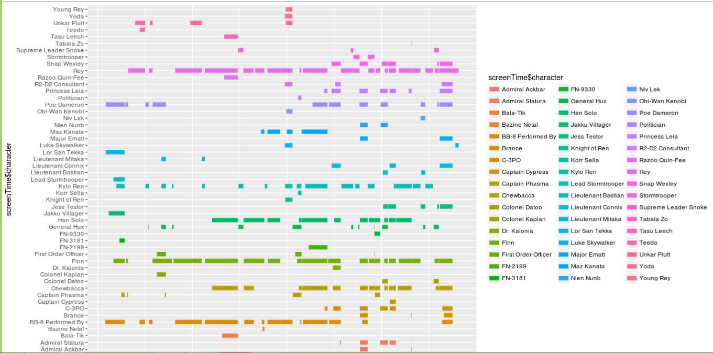
Understanding ggplot…
The second layer adds a line segment for each character and defines the size of each.
ggplot(screenTime, aes(colour=screenTime$character)) +
geom_segment(aes(x=screenTime$start, xend=screenTime$end,y=screenTime$character, yend=screenTime$character),size=3)
Ggplot2 works by adding layers so you can explicitly define the aesthetics and type of information to be visualized. Remember each layer is separated by a “+” .

Slide 85
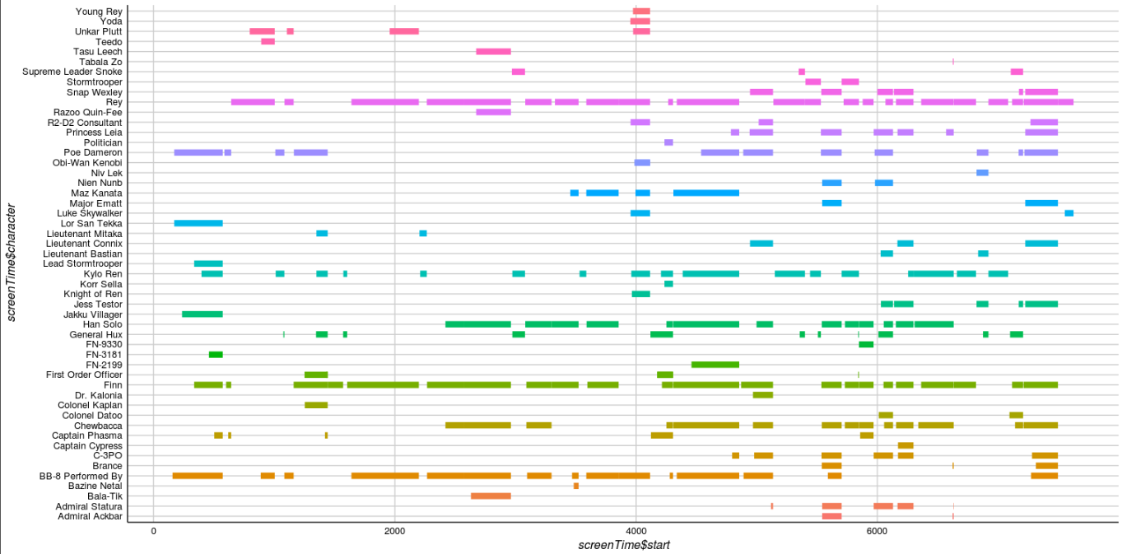
Understanding ggplot…
The third layer changes the background, axis & colors. The fourth layer removes the legend which is redundant in this context.
ggplot(screenTime, aes(colour=screenTime$character)) +
geom_segment(aes(x=screenTime$start, xend=screenTime$end,y=screenTime$character, yend=screenTime$character),size=3) +
theme_gdocs() +
theme(legend.position="none")
Ggplot2 works by adding layers so you can explicitly define the aesthetics and type of information to be visualized. Remember each layer is separated by a “+” .

Slide 86
Let’s Practice!
Open:
C_geospatial.R
read.csv
ggplot()
Google maps with ggmap
leaflet()
Open the third file, explore geospatial information.

Slide 87
Agenda
Start | End | Item
6:30 | 7:00 | Introductions
7:00 | 7:30 | Syllabus Review
7:30 | 7:45 | Community Learning Expectations
7:45 | 8:00 | Break
8:00 | 8:30 | Core Concepts in Data Mining
8:30 | 9:00 | Intro to R
9:00 | 9:30 | Q/A, Individualized help w/R environment Case Study Assignment

Slide 88
Group Assignment - Kickoff
Count off 1 to 10
All “1”s are a group etc. Find your group members.
Each group should have at 3-4 people…let me know otherwise.
As a group decide which case study is more appealing.
Spend any remaining time loading case data and exploring it with functions you are learning.
Your TA’s and I will be around to help each group as needed.

